Slide 1
androidGo
Introduction to Android App Development using Android Studio

Slide 2
Course Overview
Introduction to Android App Development
Beginning with Android Studio, Testing an App on an emulator and a physical device, Basic Terminology, Life Cycle of an Android Application
Android UI Widgets
Working with Text fields and Buttons, Switching between Activities, Working with Intents
Communication
Using API to send SMS, File I/O, Managing Permissions
Databases
Storing and retrieving data from SQLite Database
Services
Creating applications that run in the background
Building your own “SOS” App

Slide 3
Why Android?
It is open source.
Huge market share: has over a 1.4 billion users. [The Verge, September 29, 2015]
Great job prospects.
Variety of devices running Android
Great hobby to have!

Slide 4
Before starting the course you must have:
Installed the latest version of Android Studio. We are using Android Studio 2.1.2
An Android device running Android 4.4 (KitKat) or above
Intermediate level coding experience with Java

Slide 5
Resources
Installation: https://developer.android.com/studio/install.html
Use this to build colorful apps! https://developer.android.com/reference/android/graphics/Color.html
Add style to your text! https://guides.codepath.com/android/Working-with-the-TextView
If your device runs Android 6.0 (or above), use this to handle permissions at runtime. https://developer.android.com/training/permissions/requesting.html
All you need to know about connecting your application to the Cloud https://developer.android.com/training/building-connectivity.html
Be efficient with resources: https://developer.android.com/training/best-performance.html

Slide 6
Module 1: Introduction to Android Applications

Slide 7
Basic Terminology
Activity: Foreground process, tangible interface of an application that the user interacts with.
Services: Background process, no tangible UI.
Fragments: “Sub-activities” that share resources within a single activity.
Widgets: I/O components that allow the user to interact with the application.
Intents: Intents are classes that abstract certain operations like starting activities/services, broadcasting messages, etc.
Notes:
Multi-user Linux system
Multiple Platforms: Eclipse IDE, MIT App Inventor, Android Studio

Slide 8
Project Structure:
Java based code: key logic , defines activities.
The layout files: xml files that describe the layout and positioning of UI elements on the app screen
Manifests: declares the permissions provided to the application
Other resources: miscellaneous resources like hard-coded strings, hex values for color, formatting styles, etc.
Notes:
1. Java based code: This part of the project consists of the Java-based code that implements the logic behind the functioning of the application. These codes define activities (the screens visible to the user), utility functions, etc.
2. The layout files: These are xml files that describe the layout and positioning of various UI elements on the app screen. All activities are required have an xml file associated with it.
3. Manifests: Manifests declare the permissions provided to the application that govern the types of device resources it can access. The ability to read/write to external storage, accessing in-built sensors, connecting to the internet, etc. are defined in the manifest files.
4. Other resources: These are xml files that contain miscellaneous resources like hard-coded strings, hex values for color, formatting styles, etc.

Slide 9
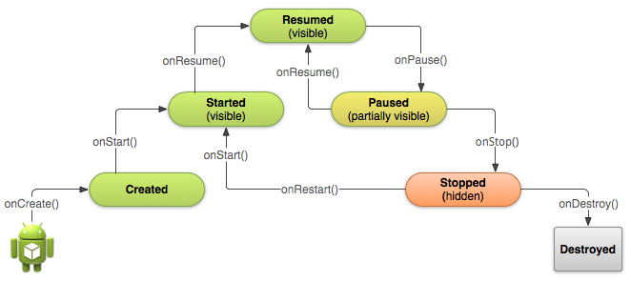
Life Cycle of an Android Application
https://developer.android.com/training/basics/activity-lifecycle/starting.html
Notes:
When an application is launched from the application menu on a physical Android device, it goes through the following stages:
On launching the application, the main activity is created, i.e., the onCreate() method of the main activity is invoked.
The onStart() method is invoked when the activity becomes visible to the user.
The activity runs as described by the onCreate()/onStart()/onResume() method.
onPause() is invoked if the activity needs to be paused due to physical constraints of the system, example, memory, processing power, etc.
onStop() is invoked when the activity is not visible to the user anymore but the application is still running in the background.
onDestroy() is invoked when the activity is shut down. If the application consists of other activities, their respective onCreate() methods are invoke.

Slide 10
Creating a New Android Studio Project
Start up Android Studio.
Go to File -> New Project.
Input a cool name for your application.
Proceed to the next screen where you would select the target platform (depends on the features you would like to use, but API 19 usually does the trick).
Create an activity on the next screen and you have your first project!
Notes:
1. Run over setting up of an Android Project

Slide 11
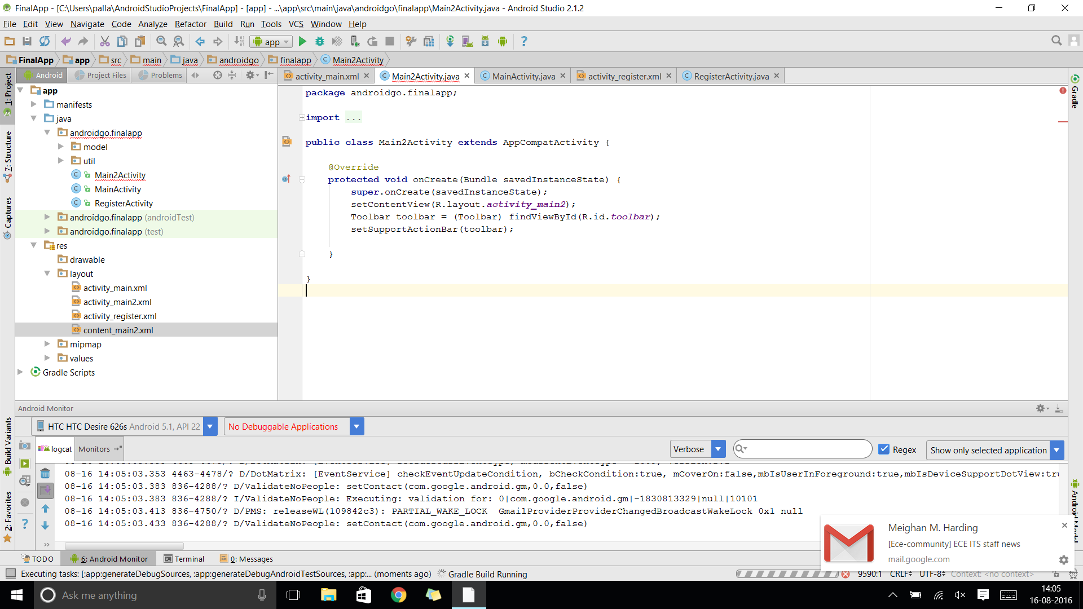
6. This is what the Java code of a basic activity would like and the onCreate() method is where all the logic goes:

Slide 12
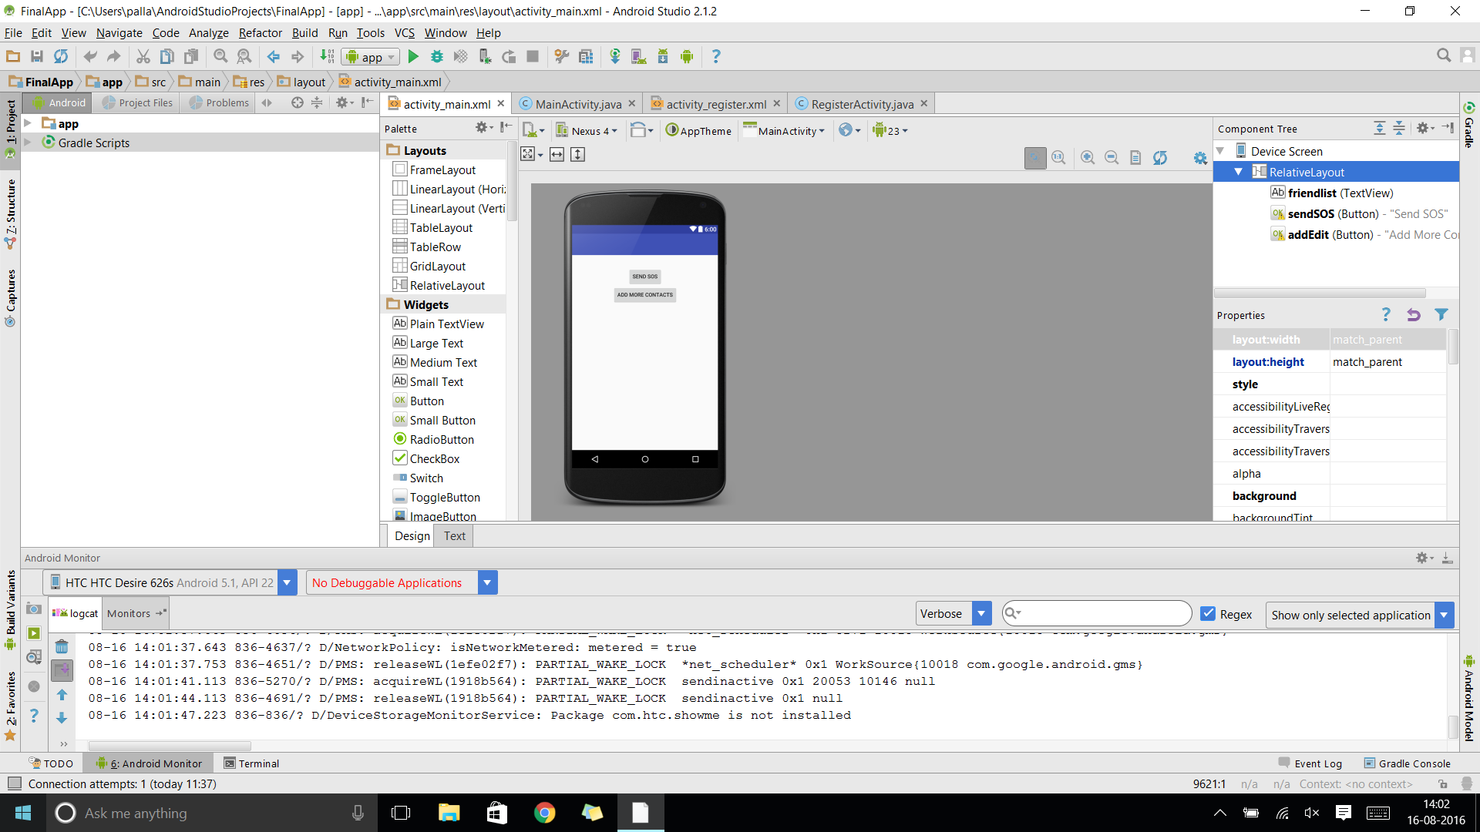
7. Use the graphical version of the layout files to add your design elements and widgets

Slide 13
Takeaway I
Setting up an Android Studio Project
Testing a small App with the Emulator and a physical device
Basic Android Terminology
Know a Life Cycle of an Android Application

Slide 14
Module 2: Android Widgets for User Interaction

Slide 15
Android Widgets
User Interface elements that allow users to interact with the application.
Used for I/O
Commonly used widgets:
Button
TextView
EditText
ImageView
Toast

Slide 16
Buttons
To create buttons programmatically :
Button button = new Button(context);
To refer to previously created elements in the layout files:
Button button = (Button) findViewById(R.id.button);
To implement Listeners:
button.setOnClickListener(new View.OnClickListener() {public void onClick(View v) { // Perform action on click });

Slide 17
TextView
Used to display text
Can be formatted to change text color, size, font
Textview textview = new Textview(context);

Slide 18
EditText
Allows for user input.
Input types can be specified to limit user input to plain text, numbers only, email fields, passwords, etc.
String string = editText.getText().toString()

Slide 19
ImageView
Used to load images from internal application resources, device resources or URLs (if connected to the internet).
setImageResource() is used to add images to the ImageView by resource IDs or bitmaps or drawables
imageview.setImageResource(resId);
imageview.setImageBitmap(bitmap);
imageview.setImageDrawable(drawable);

Slide 20
Toast
“Volatile” popup notifications that appear on the screen
Used for feedback
Toast toast = Toast.makeText(context, "My Message", lengthOfToast);
toast.show();

Slide 21
Assignment I
Create an application that accepts a string input from a user (stating a color) and displays that color in an ImageView. The first activity must consist of two fragments, one containing an EditText and the other containing a “Show Color” button. The second activity must contain an ImageView that displays the color.

Slide 22
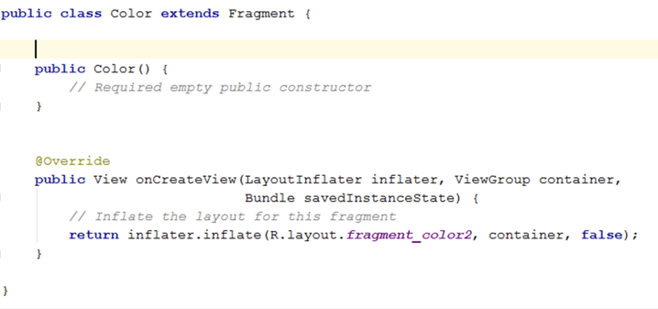
Approach
Create a new project that consists of two activities and two fragments.
Incorporate the two fragments within the first activity.

Slide 23
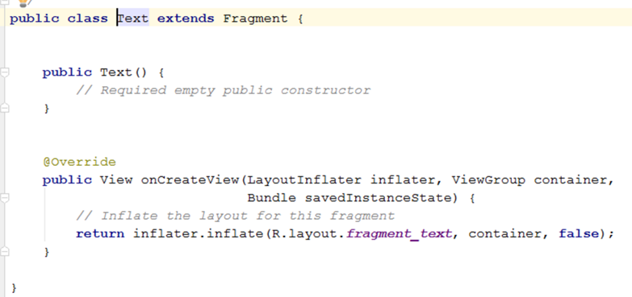
3. Declare all required variables.
4. Add an EditText to one fragment and a Button to the other fragment. These widgets can be found in the graphical interface of the respective layout XML files.

Slide 24
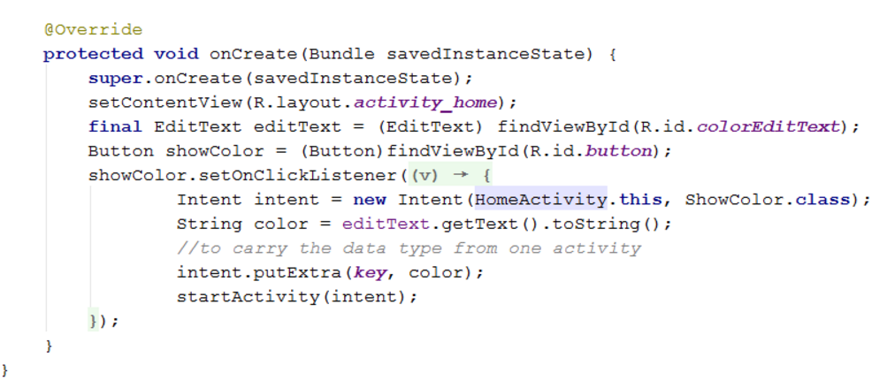
5. Use an Intent in the onClickListener of the button to switch to the second activity. Bind the user input from the EditText to this intent.

Slide 25
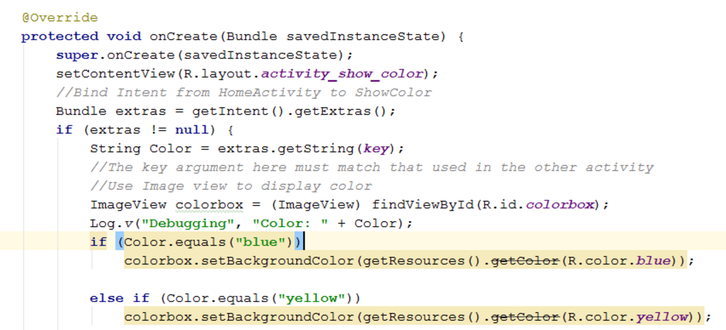
6. Add an ImageView to the second activity.
7. Set the background of the ImageView to the color entered by the user.

Slide 26
Takeaway II
Working with UI Widgets
Using Intents to Switch between Activities
Using Fragments within an activity

Slide 27
Module 3: Communication

Slide 28
Communication
Building an app with capabilities for communication
Modifying permissions to allow for communication
Notes:
This module describes how to build an app with capabilities for communication, say for example, for the purpose of sending an SMS. They key point with regard to building connected apps is providing the right permissions that allow for communication. As discussed earlier, permissions can be modified within the Manifest file.

Slide 29
Sending an SMS:
Use the SMSManager Class.
Get the object by calling the static method getDefault()
SmsManager manager = SmsManager.getDefault();
manager. sendDataMessage(String destinationAddress, String scAddress, short destinationPort, byte[] data,PendingIntent sentIntent, PendingIntent deliveryIntent)

Slide 30
Modifying Permissions
Android OS requires permissions to use protected features like accessing storage, contacts, calendar etc.
By default, no permissions are granted.
To add permissions to your app, modify the AndroidManifest.xml file
Example Permissions:
<uses-permission android:name="android.permission.SEND_SMS"/>

Slide 31
Assignment II
Create an application that accepts a phone number and the text message from the user and sends the message to the phone number. Also save the phone number and the text message to a file stored in external storage on the phone.

Slide 32
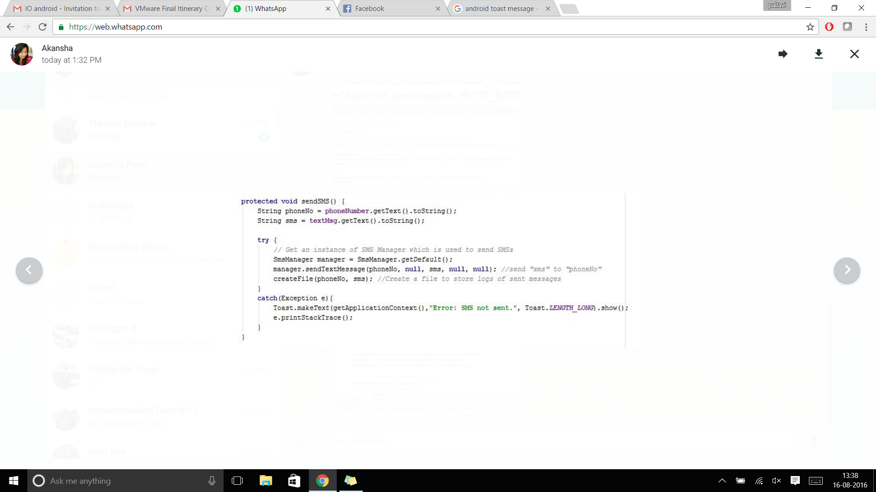
Approach:
Create a new project that consists of one main activity.
Declare all required variables.
Add an EditText widgets to enter a phone number and the message and a SEND button.
Set up the SMS Manager to handle communication.

Slide 33
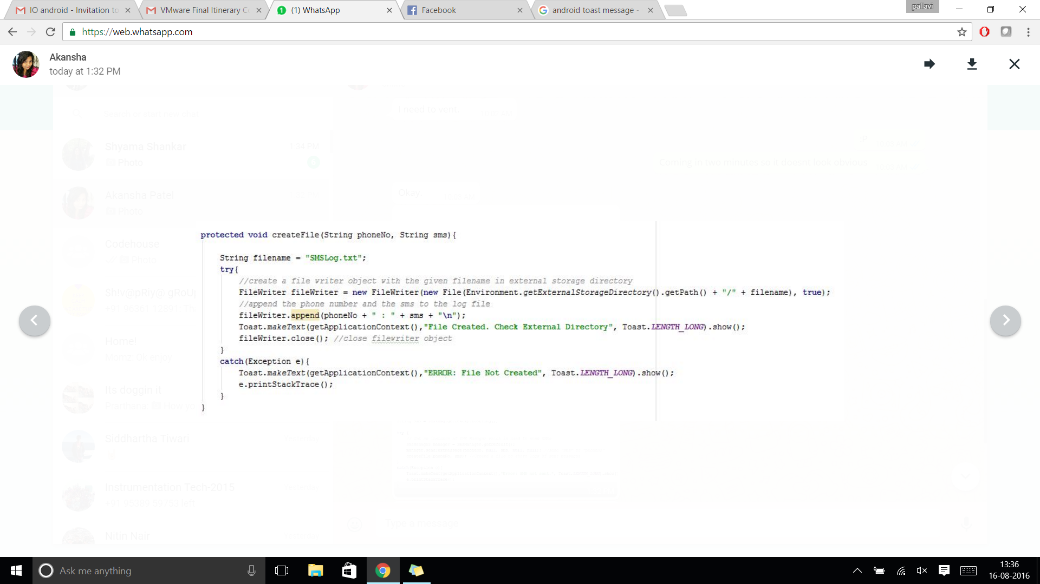
5. Set up FileIO to maintain a log of the messages sent.

Slide 34
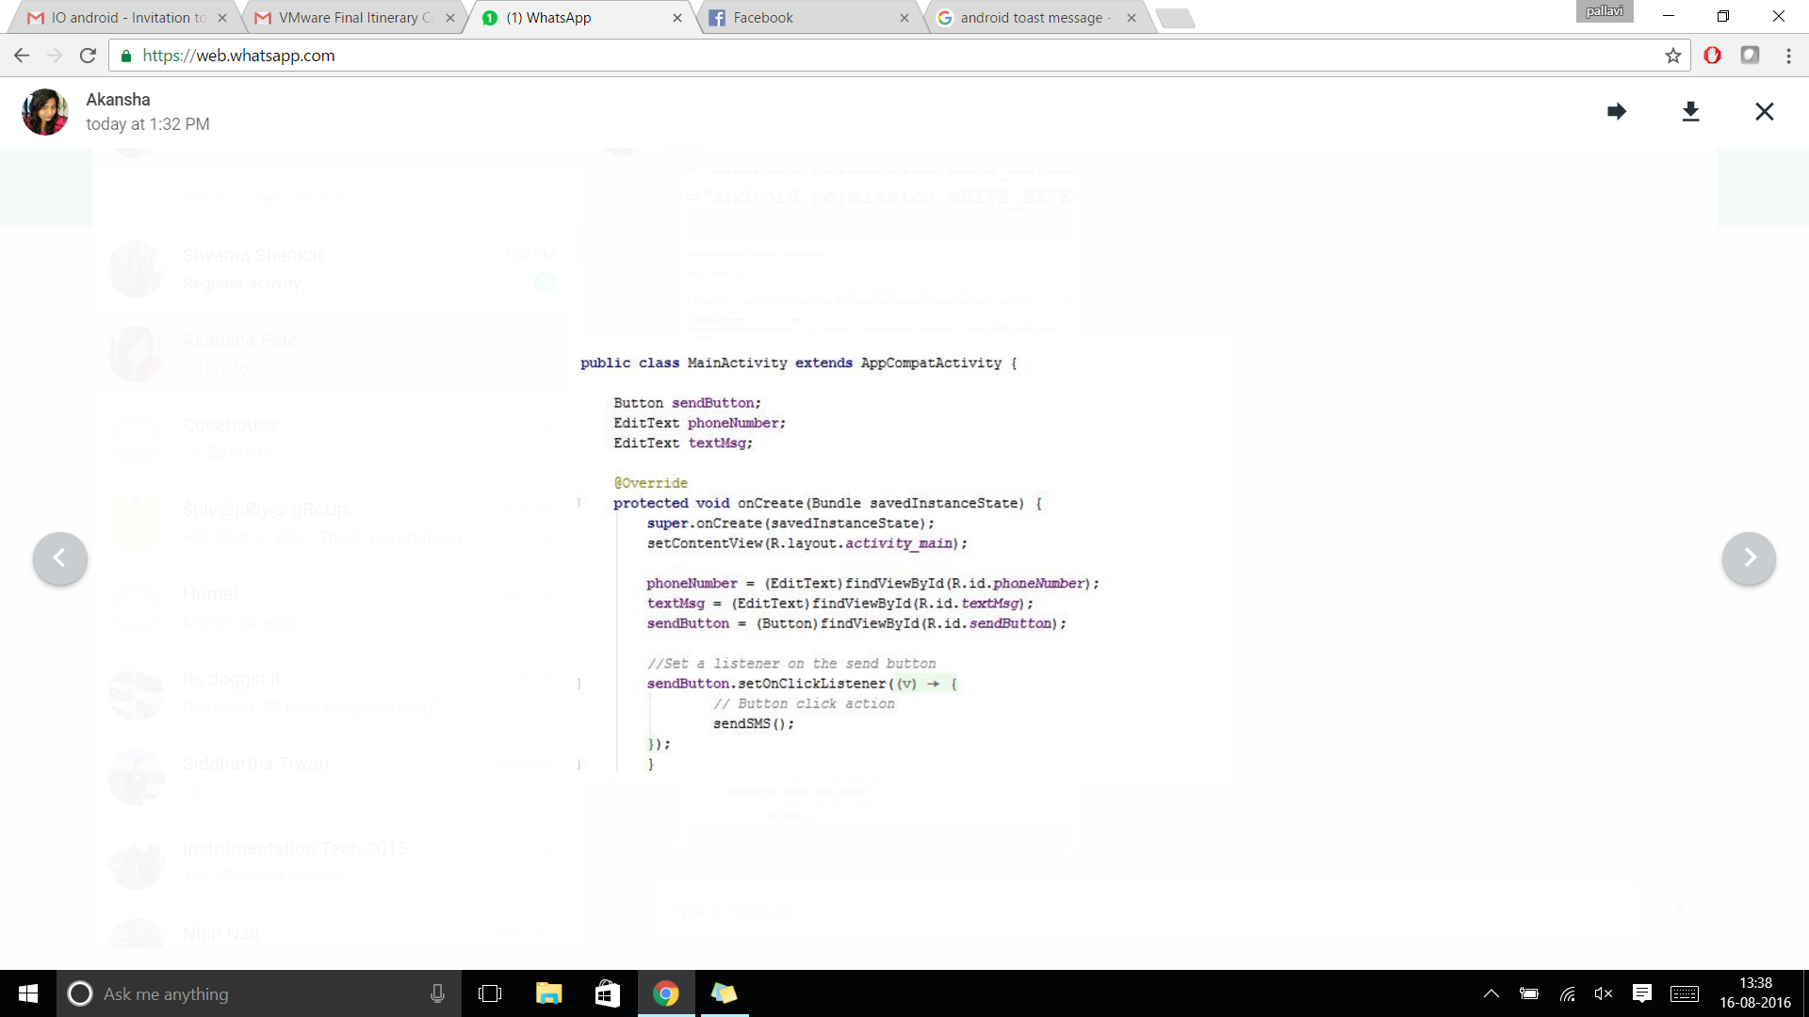
6. Use an onClickListener to send the SMS and write to the log file when the SEND button is clicked.

Slide 35
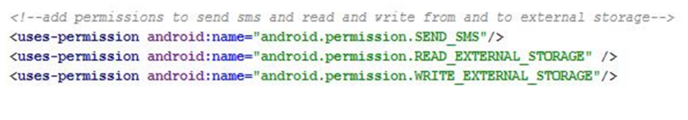
7. Remember to add permissions in your Manifest file!

Slide 36
Takeaway III
Understand how to enable GSM communication
Understand File I/O
Managing permissions

Slide 37
Module 4: Storing Your Data

Slide 38
Databases
SQLite is used for data storage and retrieval in Android
SQLite is integrated and requires no additional installations or set-up
Classes that implement SQLite operations are available in the android.database.sqlite package

Slide 39
Creating the Database
Create the database by extending the SQLiteOpenHelper class.
Create tables inside the onCreate() method of this class.
Example Query:
private static final String CREATE_QUERY = "CREATE TABLE tableName (column_id INTEGER PRIMARY KEY AUTOINCREMENT, column_1 TEXT, column_2 NUMERIC);";

Slide 40
Opening and Closing the Database:
To open for writing:
SQLiteDatabase database = databaseOpenHelper.getWritableDatabase();
To open for reading:
SQLiteDatabase database = databaseOpenHelper.getReadableDatabase();
To close the database:
database.close();

Slide 41
Inserting Data into the Database
Get writeable database by using the getWritableDatabase() method in SQLiteOpenHelper
Bind the values to be inserted into an object of ContentValues type
ContentValues contentValues = new ContentValues(); contentValues.put(COLUMN_NAME, VALUE);
Create an entry in the table
database.insert(TABLE_NAME, null, contentValues);

Slide 42
Retrieving the Data from the Database
Get readable database by using the getReadableDatabase() method in SQLiteOpenHelper
Run query and get the result in Cursor
private static final String QUERY = "SELECT * FROM " + TABLE_NAME;
Cursor cursor = database.rawQuery(QUERY, null);
Use the cursor object to get the column values
String column_1_value = cursor.getString(0);

Slide 43
Assignment 3
Create an application that allows the users to save and retrieve contacts information (name and phone number). Implement a SQLite database with a basic table that includes columns name and phone number.

Slide 44
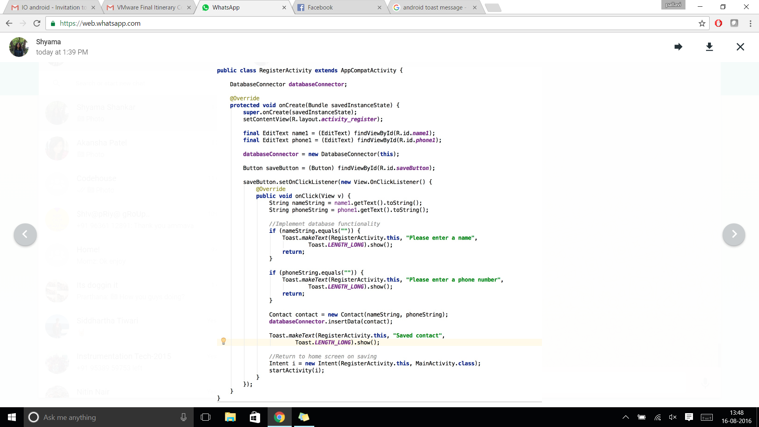
Approach:
Create a new project that consists of one main activity.
Declare all required variables.
Add an EditText widgets to enter contact details, a SAVE button and a TextView to display data retrieved from the database.

Slide 45
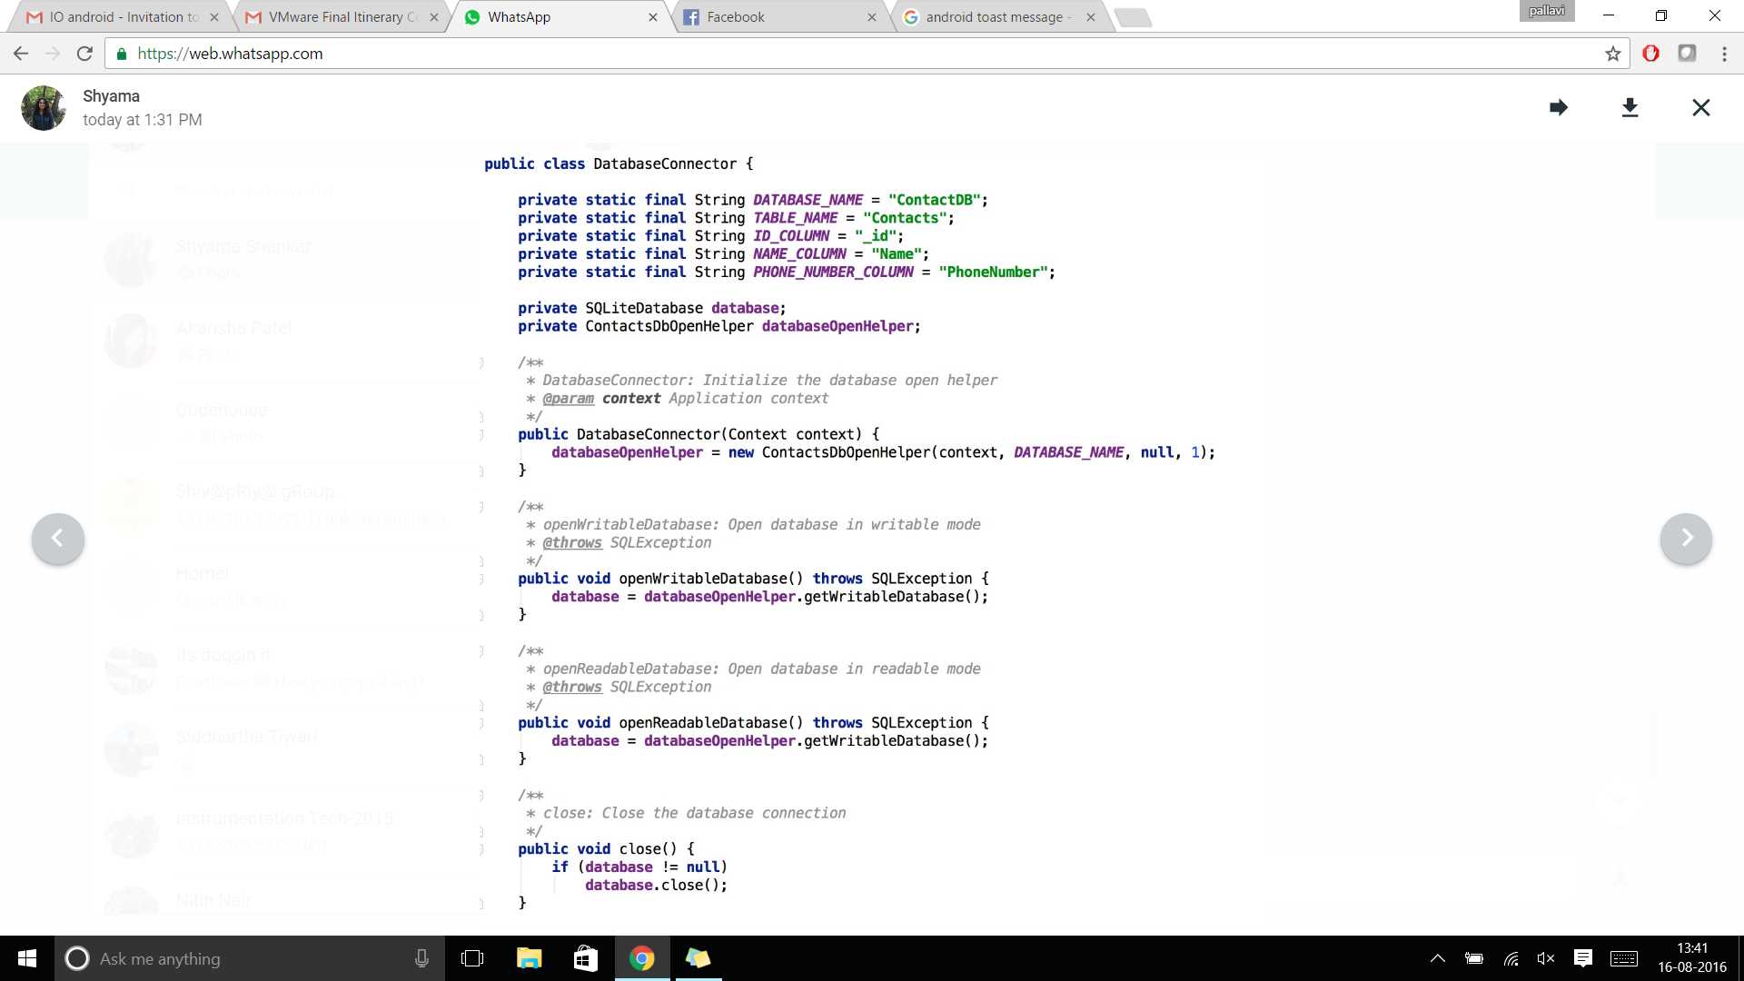
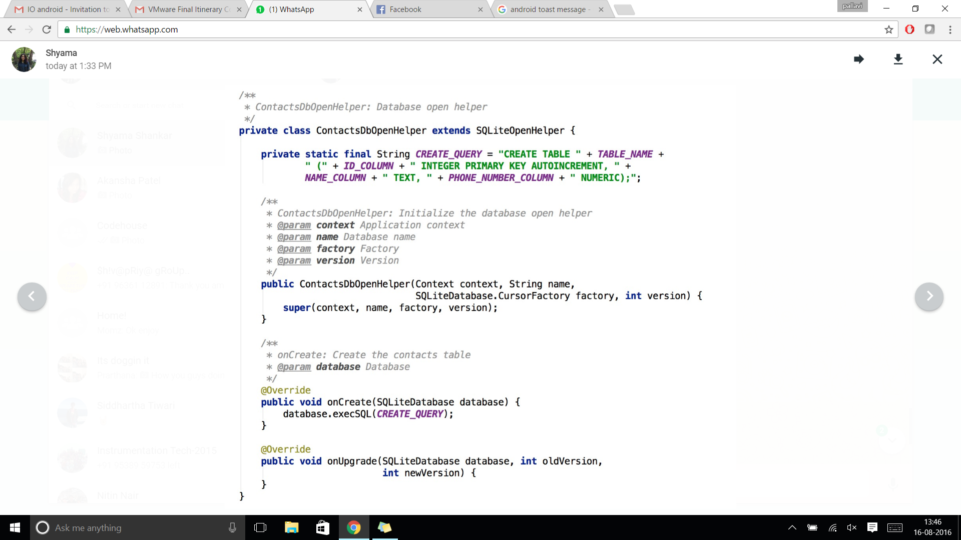
4. Initialize the database and create the relevant tables.

Slide 46
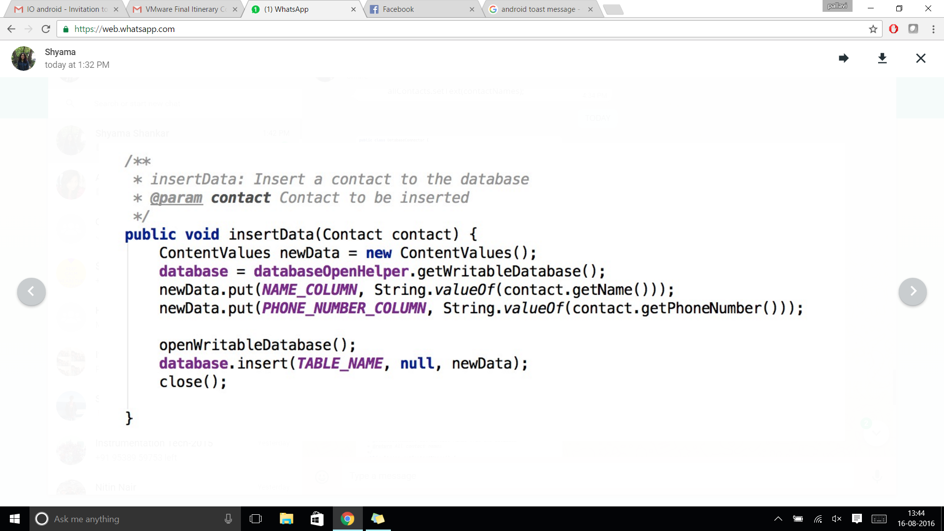
5. Implement the CRUD operations.

Slide 47
6. Use an onClickListener to save a contact to the database when the SAVE button is clicked.

Slide 48
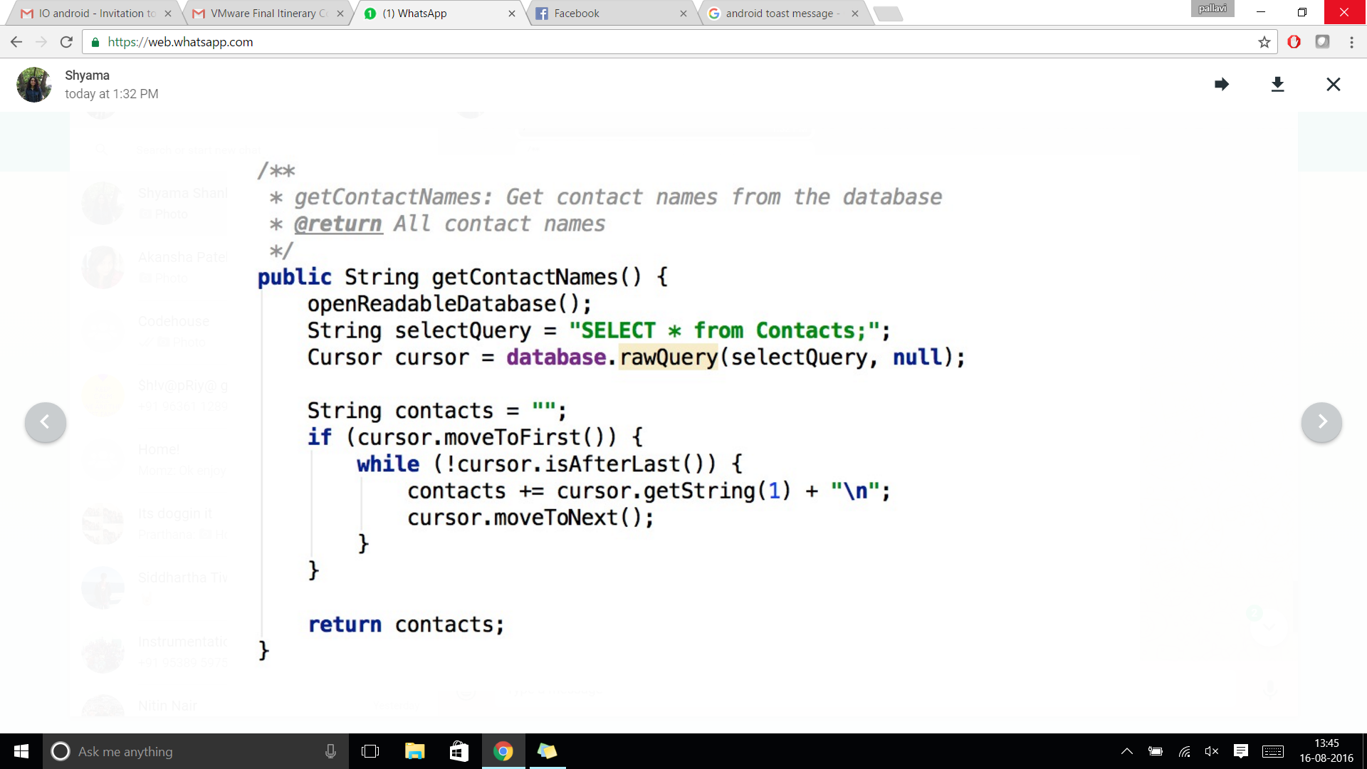
7. Read data from the database and display in the TextView.

Slide 49
Takeaways IV
Creating and retrieving data from a SQLite database

Slide 50
Module 5: Background Applications

Slide 51
Services
Services provide functionalities that run in the background
Similar to Activities but have no UI.
Declared separately within the Android Manifest file
Extended from the Service class.
onCreate() method initiates the service.
Applications can interact, send requests, and receive results from a service using the onBind() method.

Slide 52
Assignment 4
Create an application that works in the background to calculate the user’s location (latitude and longitude) and displays the same via a Toast message on the device’s home screen.

Slide 53
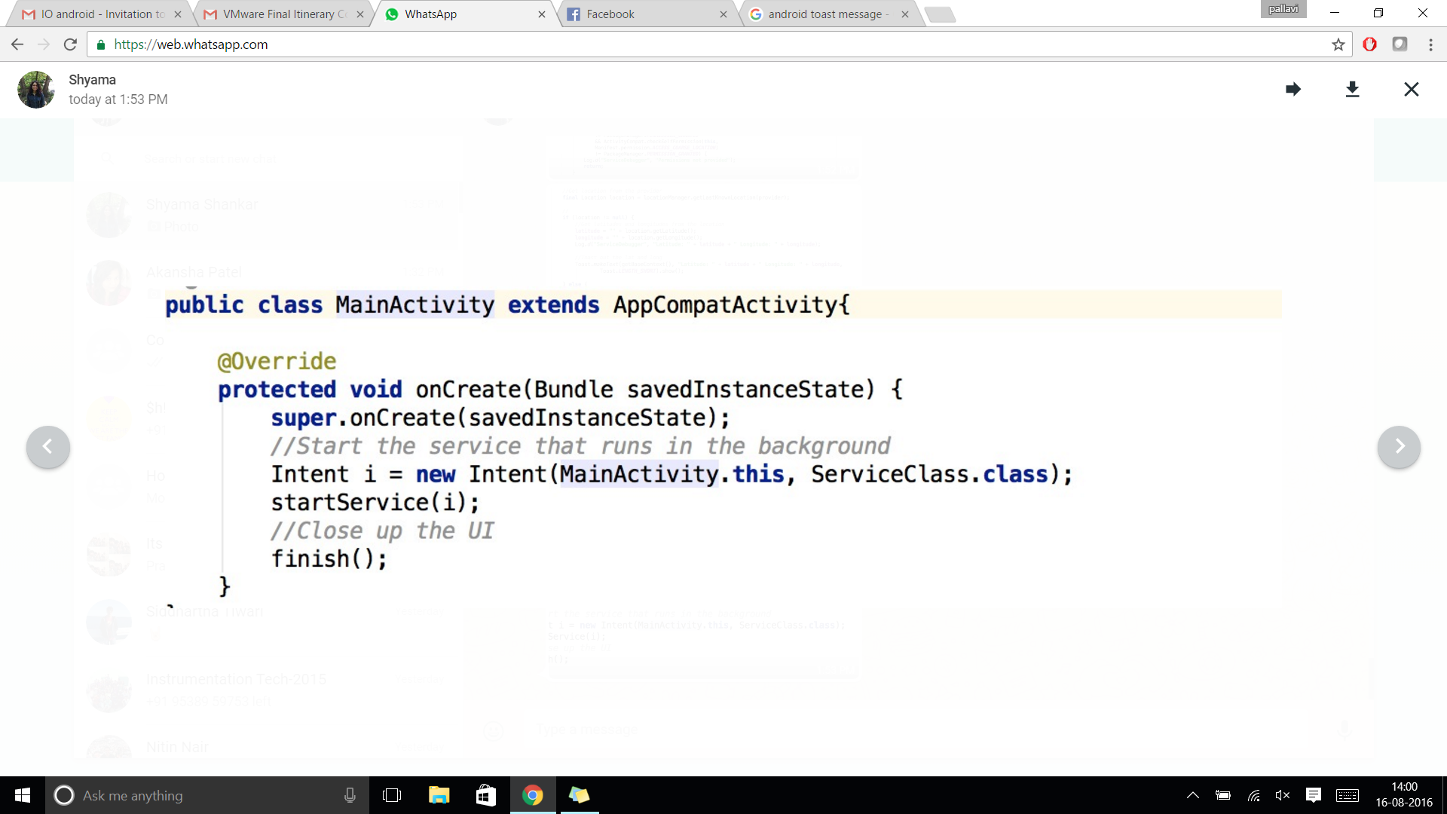
Approach
Create a new project with an activity and a service.
The onCreate() method of the activity is invoked when the app is started from the device. Here, we remove the bit of code that we generally use to associate a layout file with an activity.
Start the service using the startService() call.

Slide 54
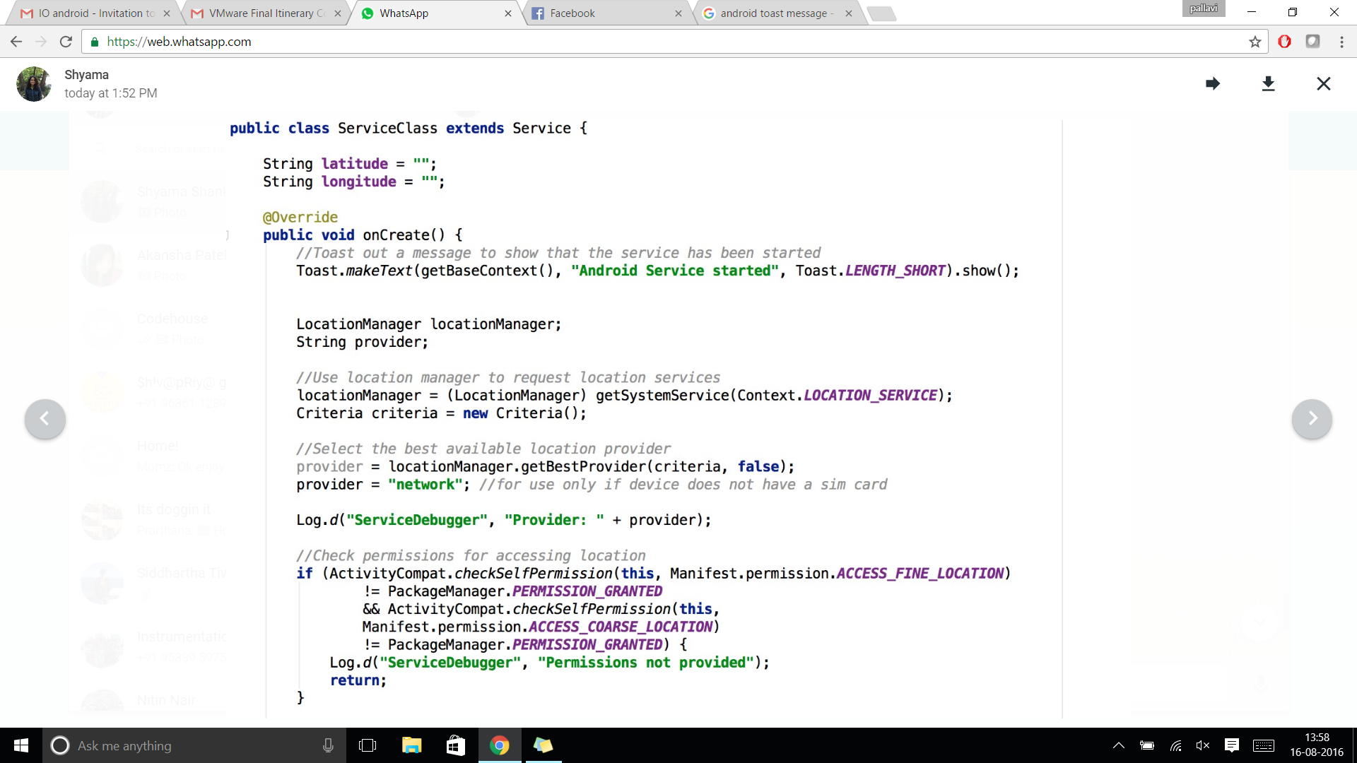
4. Within the service, use the Location manager to obtain the GPS location of the device.

Slide 55
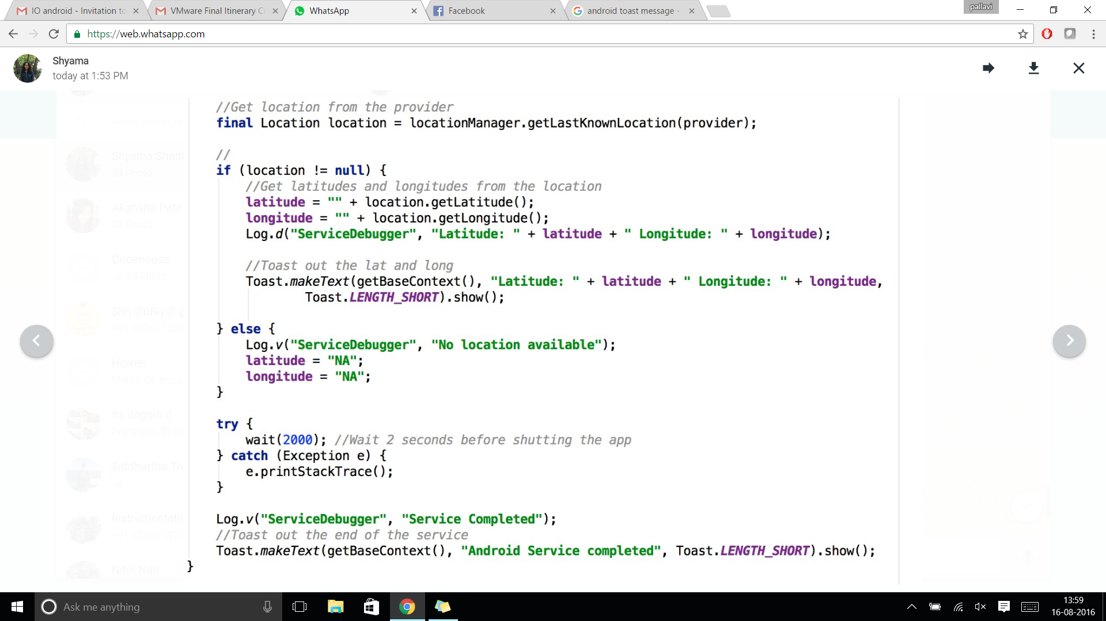
5. Toast messages to the homescreen while the compute happens in the background.

Slide 56
Takeaways V
Implement functions that run in the background

Slide 57
MODULE 6: “Save My Soul” BUILD YOUR OWN SOS APPLICATION

Slide 58
Problem Statement
Create an Android application that allows users to send SOS messages in times of need to a set of (emergency) contacts. The application, on the first run, must prompt the user to enter at least one contact, details of which are stored in a local SQLite database. During a crisis (of any kind) the user must be able to open the app and click one button that sends an SOS message, consisting of the user’s location, to all the contacts that were defined previously. The process of calculating location and sending SMSs must occur in a background service. Additionally, the user must also be able to add new contacts whenever he/she desires.

Slide 59
Approach
Decide on the number of activities and the types on IO widgets on each activity.
Determine if the application is being launched for the first time, in which case, redirect to the activity that accepts contact details.
Implement database functions to add contact details to a SQLite database.
Implement methods to calculate the GPS location and send and SMS. Combine these methods into a Service.
Run a loop that calls the service until a message is sent to each contact.

Slide 60
Want some Extra Credit?
Implement methods to prevent the user from entering the same contact twice.
Implement methods to allow updating/deletion of an existing contact.
Implement error handling techniques so that your application never crashes.
Use formatting styles (resources in the appendix) to make your app stylish!

Slide 61
Course Take-Aways
Learn how to setup your Android development environment.
Gain Android development experience with the following mini-projects:
IO (handle user interaction)
Communications (use network connections)
Database (local data storage)
Services (have your app run in the background)
Create your own "SOS" Android application, allowing you to share your location via SMS.

